Slide 1
Practical Machine Learning
Real / fake job posting prediction
Tomeh Lara

Slide 2
Roadmap
STAGE 01
A report about the data was generated using data prep in order to form the basic idea about it.
Data cleaning and EDA
STAGE 03
Natural language processing.
STAGE 02
STAGE 04
STAGE 05
Converting text data into vectors.
Modeling & model evaluation
Deleting the stop words.
Deleting punctuation.
Lemmatizing
Count vectorizer.
TF-IDF vectorizer.

Slide 3
Supervised methods :
Support Vector Machine
Decision Trees Classifier
Unsupervised methods :
KMeans clustering
OPTICS clustering

Slide 4
Converting text data into vectors:
Count Vectorizer transform a given text into a vector on the basis of the count of each word that occurs in the whole text .
TF-IDF calculates the frequency of a word in the corpus and provides a numerical representation of how important a word is for statistical analysis.
N-gram, unigram, bigram, and sometimes trigram was used.

Slide 5
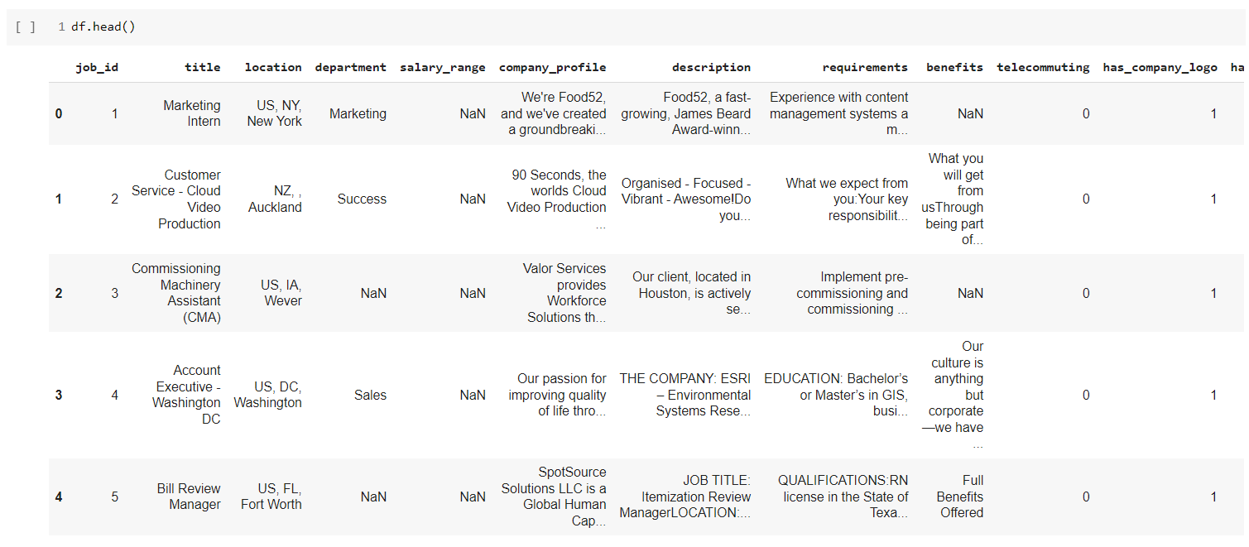
Dataset…

Slide 6
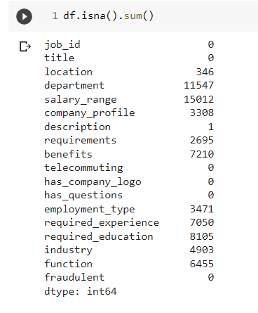
Nan values…

Slide 7
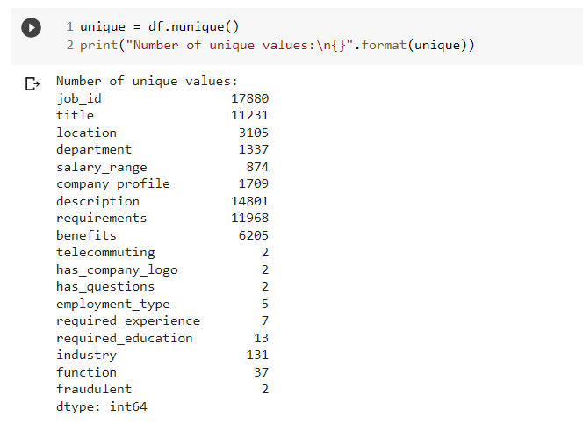
Unique values…

Slide 8
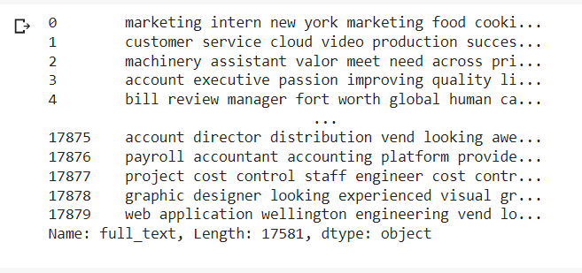
Dataset after processing…

Slide 9
Support Vector Machine - 1

Slide 10
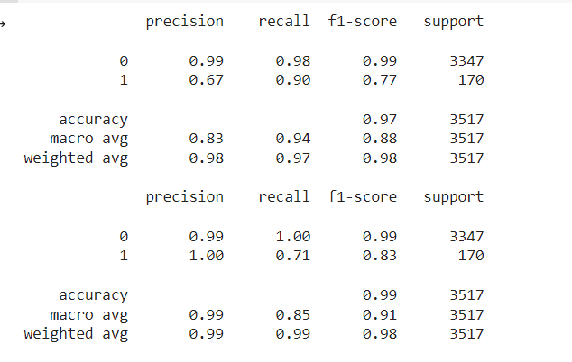
Accuracy Score

Slide 11
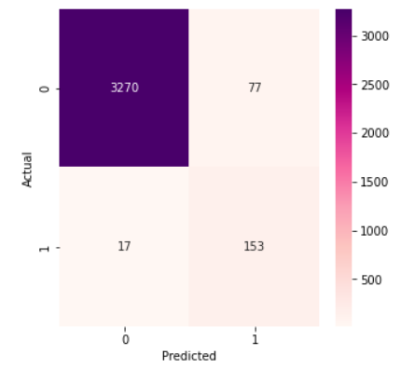
Confusion matrix – count vectorizer

Slide 12
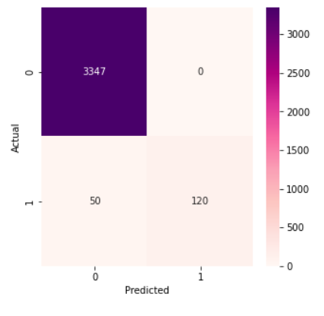
Confusion matrix – tfidf vectorizer

Slide 13
Support Vector Machine - 2

Slide 14
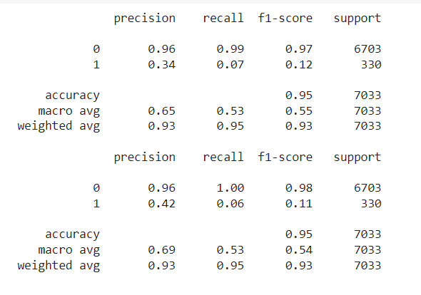
Accuracy Score

Slide 15
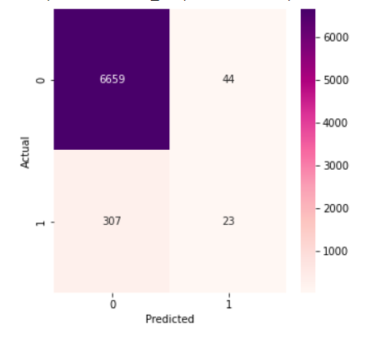
Confusion matrix – count vectorizer

Slide 16
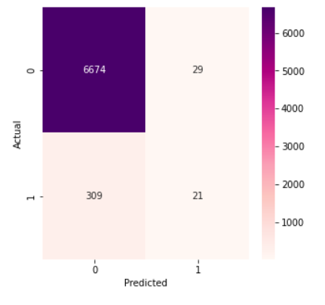
Confusion matrix – tfidf vectorizer

Slide 17
Decision Trees - 1

Slide 18
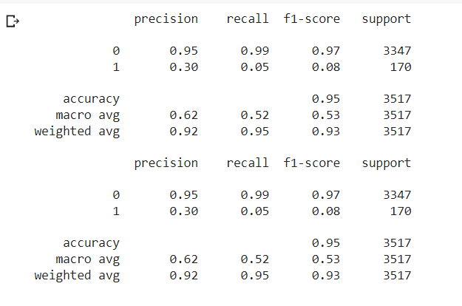
Accuracy Score

Slide 19
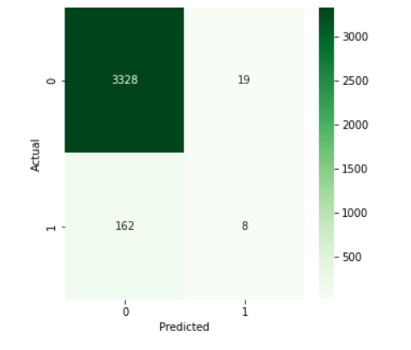
Confusion matrix – count vectorizer

Slide 20
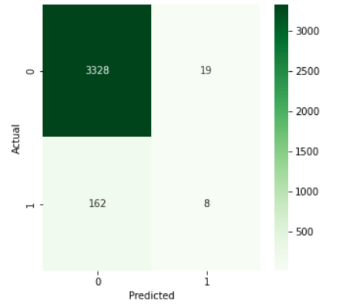
Confusion matrix – tfidf vectorizer

Slide 21
Decision Trees - 2

Slide 22
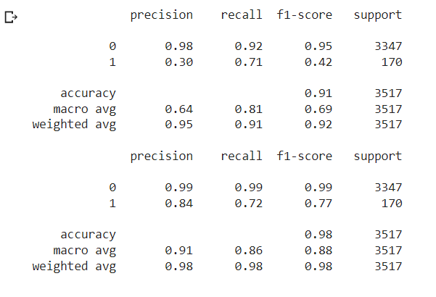
Accuracy Score

Slide 23
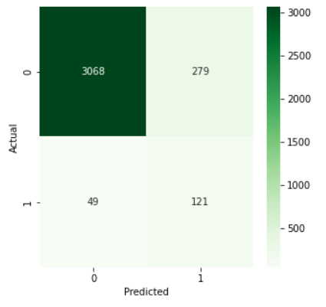
Confusion matrix – count vectorizer

Slide 24
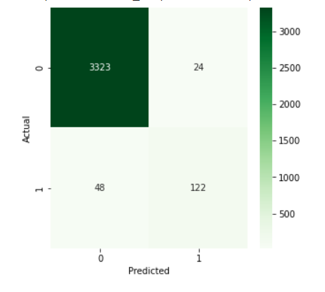
Confusion matrix – tfidf vectorizer

Slide 25
KMeans Clustering - 1

Slide 26
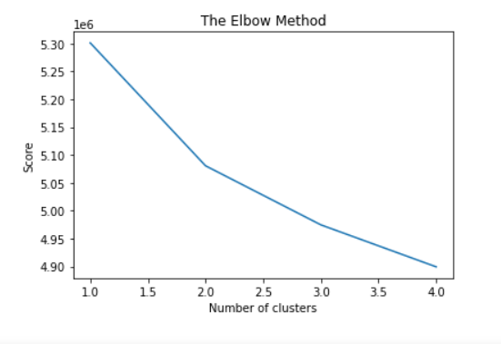
Elbow ..

Slide 27
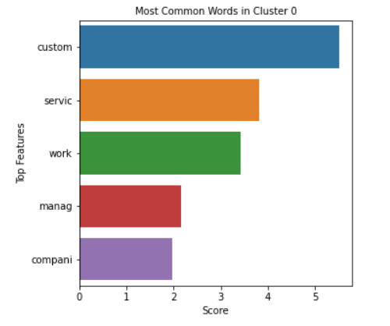
Top words in each cluster

Slide 28
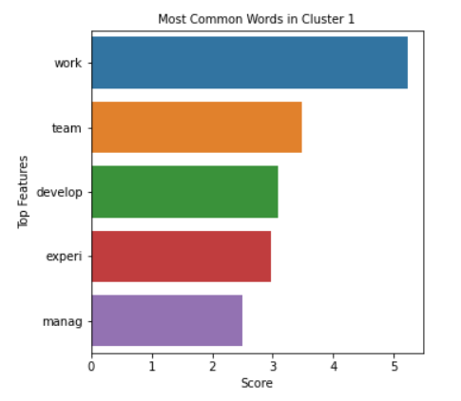
Top words in each cluster

Slide 29
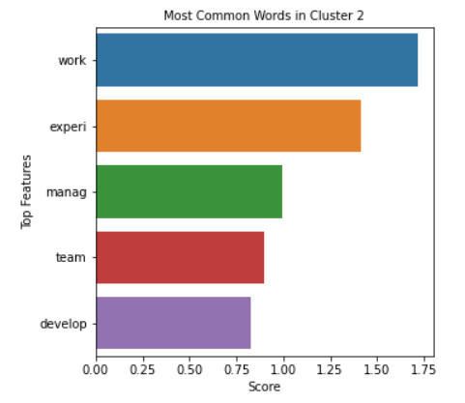
Top words in each cluster

Slide 30
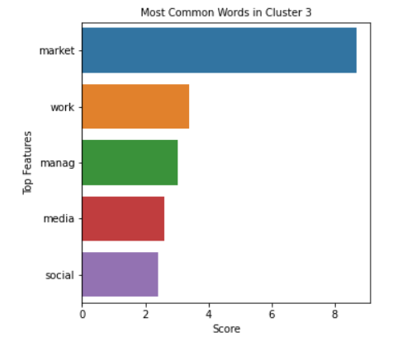
Top words in each cluster

Slide 31
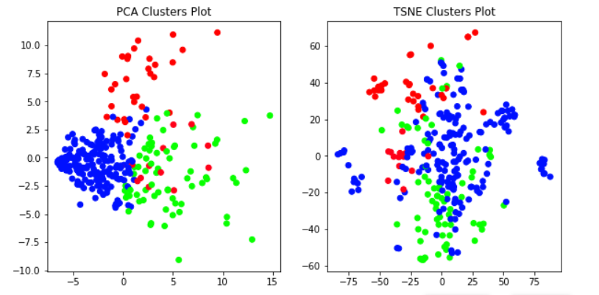
Pca & tsne clusters plot

Slide 32
KMeans Clustering - 2

Slide 33
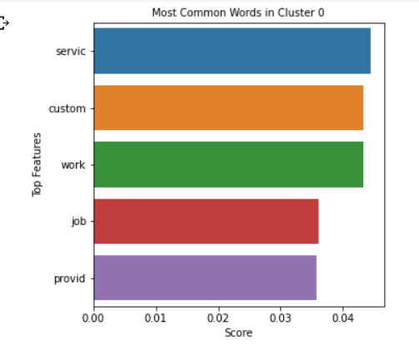
Top words in each cluster

Slide 34
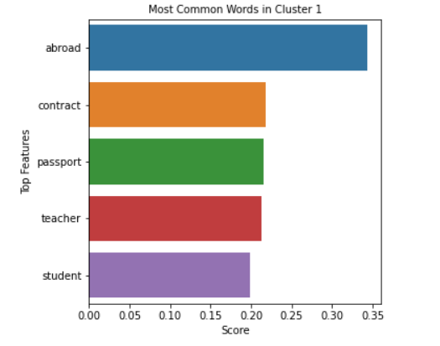
Top words in each cluster

Slide 35
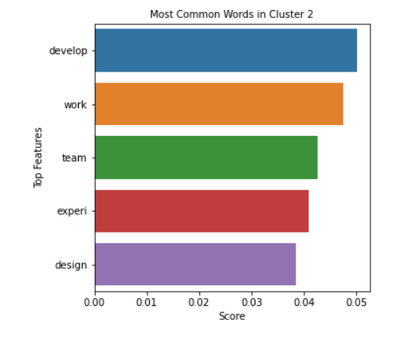
Top words in each cluster

Slide 36
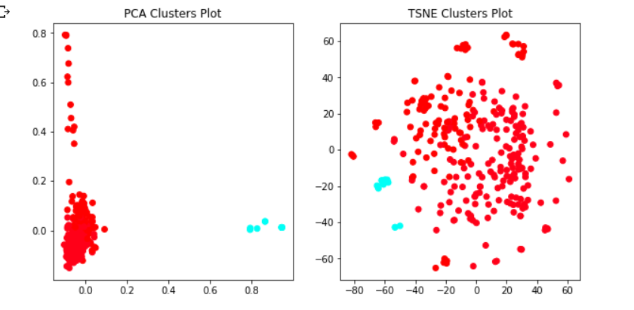
Pca & tsne clusters plot

Slide 37
OPTICS Clustering

Slide 38
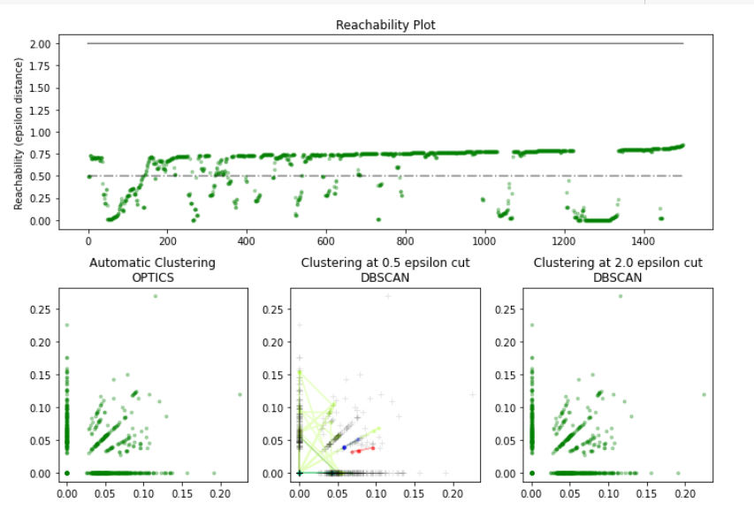
clusters plot

Slide 39
Conclusion
In conclusion, we found that the Tf-Idf vectorization in the majority achieved better results than the count vectorizer, in addition to the fact that the highest results were reached using the algorithm of the Linear support vector classifier for supervised algorithms, and unsupervised algorithms take a long time to execute, but it achieves good results and, in this project, KMeans was better, and its ease of implementation is its best feature.

Slide 40
Contact us
LinkedIn linkedin.com/in/lara-tomeh-b8347a158
Email laratomeh@gmail.com

